Slide 1
Gina vs. Shiro
A image recognition project about cats
Stefano Amalberti, Lorenzo Mantero, Gina, Shiro

Slide 2
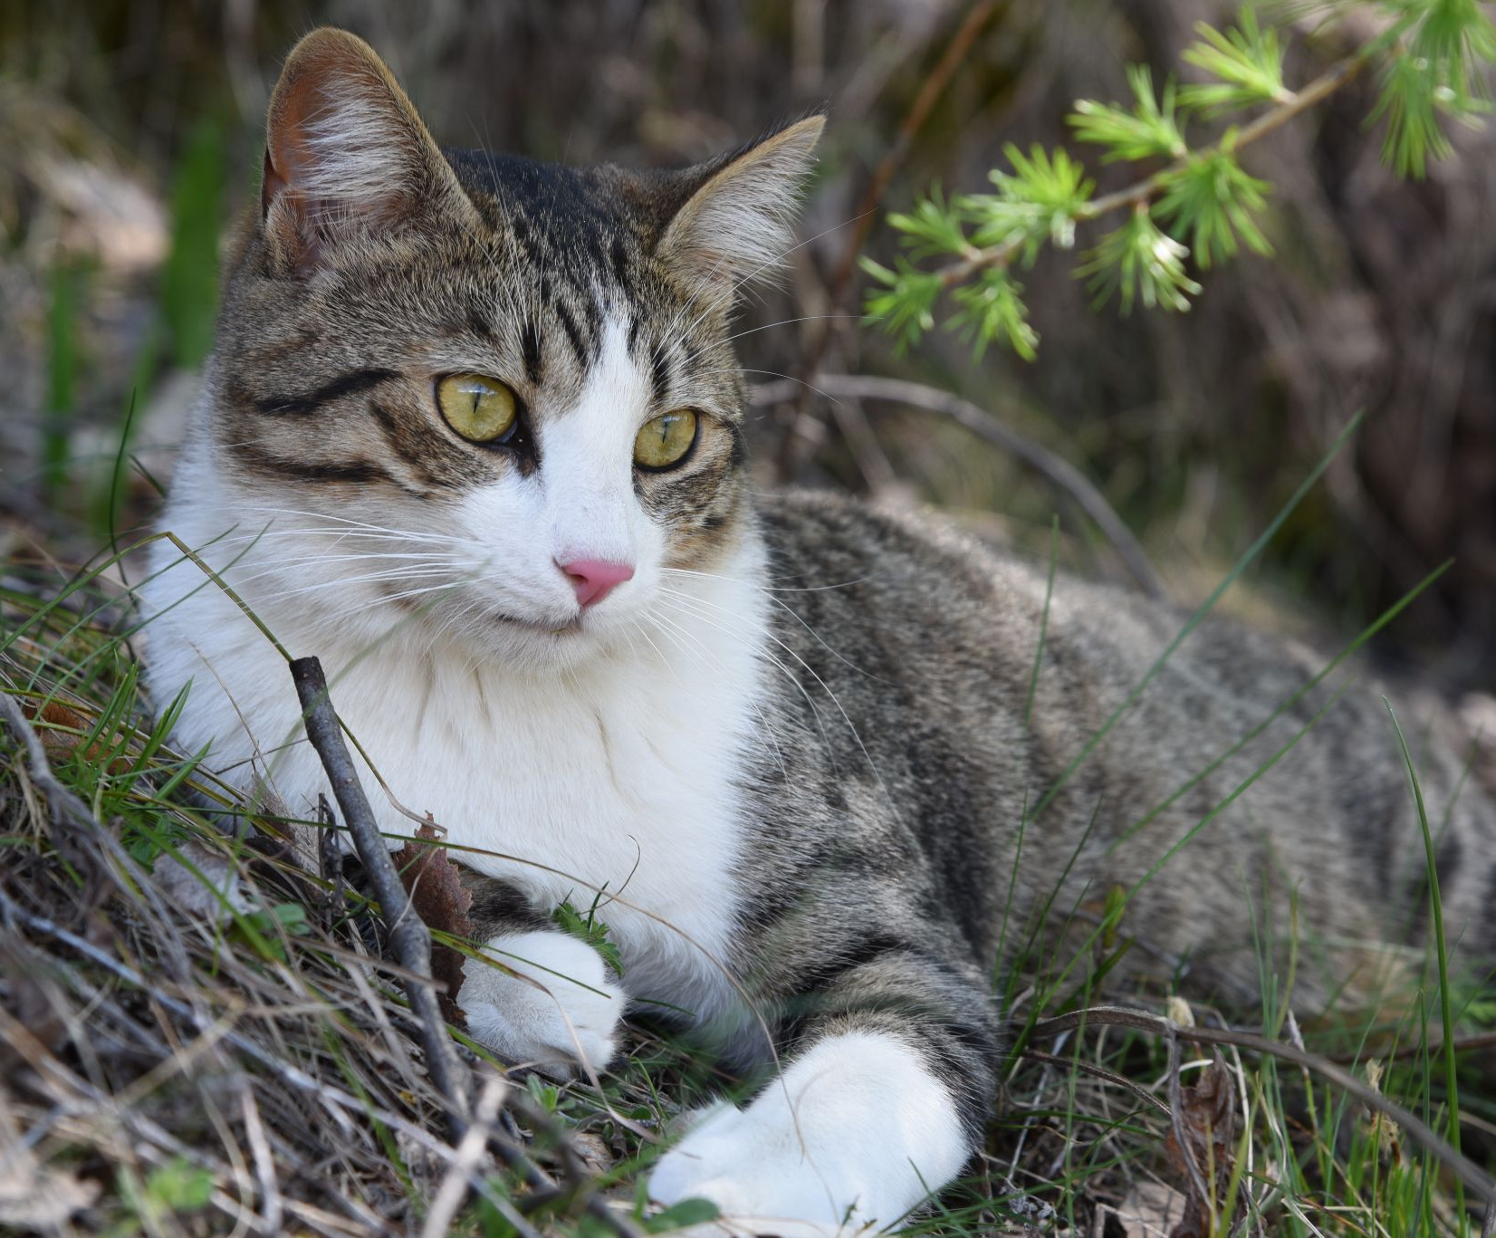
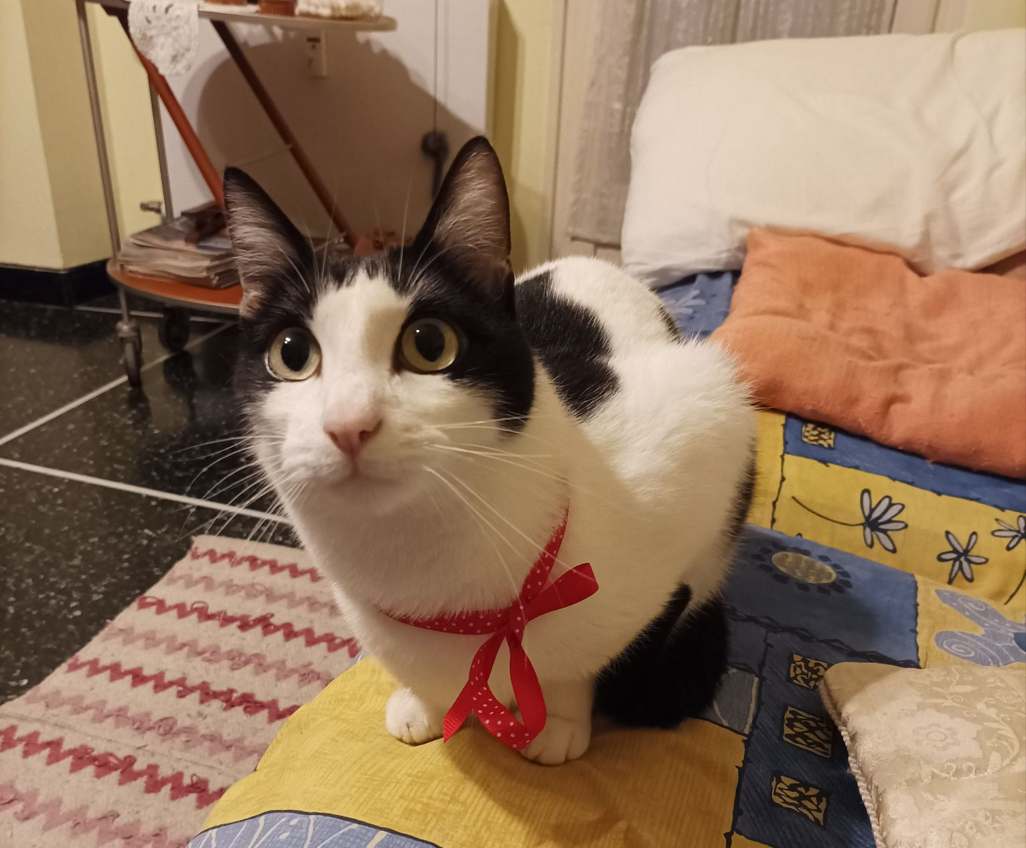
Gina
Shiro

Slide 3
Motivation

Slide 4
Motivation
  We wanted to verify the effectiveness of transfer learning on a very limited dataset.
  We love cats.

Slide 5
Description of the dataset

Slide 6
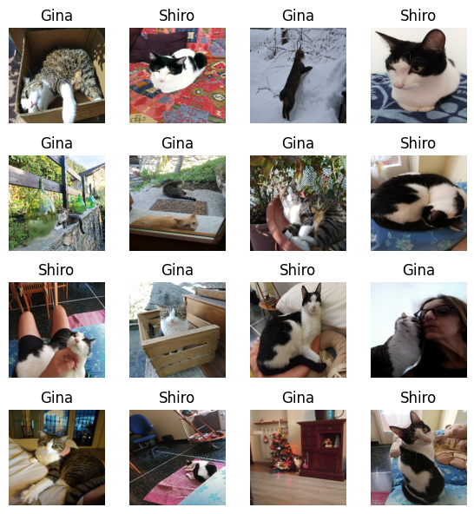
Description of the dataset
We put together a dataset of about 300 images.
about 25 were used for testing (8%)
about 50 were used for validation (16%)
The dataset is far from IID (since all images were taken by us).

Slide 7
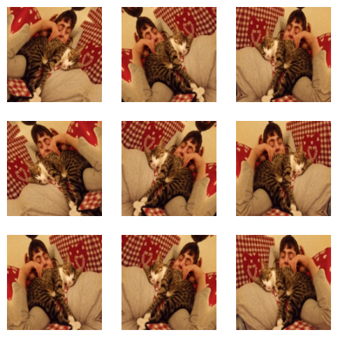
Data Agumentation
To enrich the dataset we applied some data augmentation:
randomfFlip
ramdomRotation
We also tried adding
randomSaturation
randomContrast
randomZoom
and the results were about the same

Slide 8
Model architecture

Slide 9
Model architecture
Pre-trained Xception model with ImageNet weights
Data augment. and rescaling
Global Average Pooling 2D
Dropout
Dense
Input
Output

Slide 10
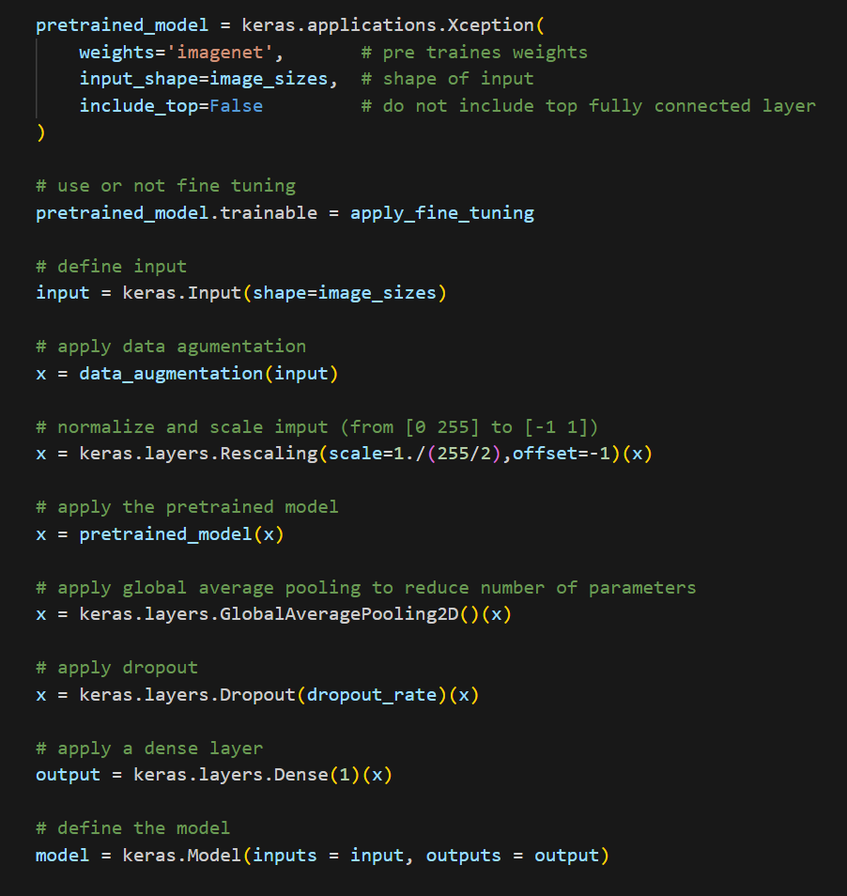
Model architecture
apply_fine_tuning is a variable that we can set to True or False, to evaluate the effectiveness of fine tuning.

Slide 11
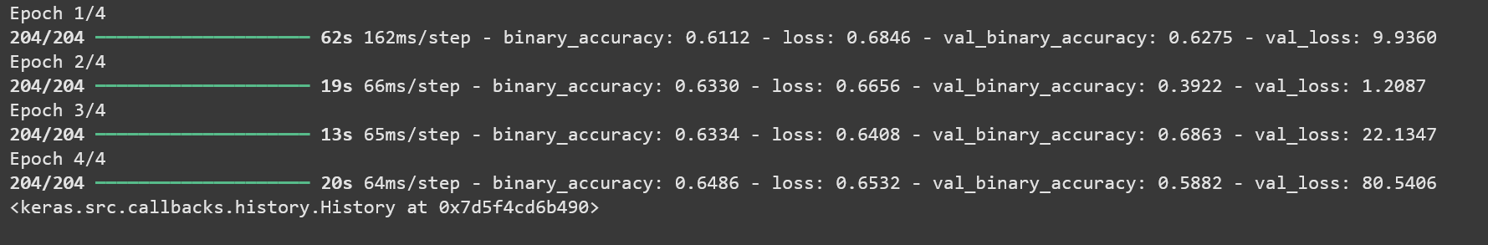
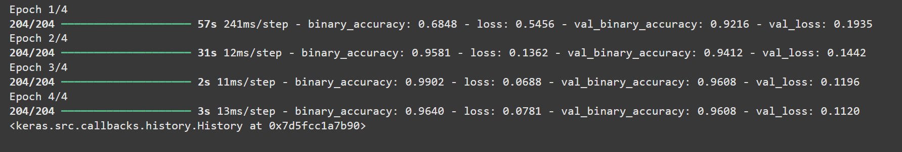
Fine Tuning
Fine Tuning:
No Fine Tuning:
Nota a piè di pagina

Slide 12
Training parameters
Observations
Based on our testing, it appeared that 4 epochs were enough to get good results.
We used the Adam optimizer, and tested the following values for the learning rate:
  Learning rate = 10⁻⁵ gives a worse result.
  Learning rate = 10⁻³ is the default value and gives the best result.
  Learning rate = 10⁻² causes overfitting (more noticeable with increasing epochs).
Nota a piè di pagina

Slide 13
Model test and conclusions

Slide 14
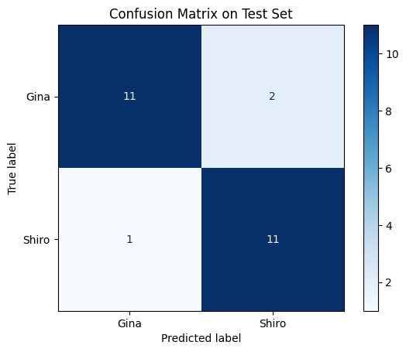
Error on the test
The error on the test ended up being pretty good with only 3 of the 25 samples being misclassified (about 12% error).
To avoid bias, the testing dataset was only used once.

Slide 15
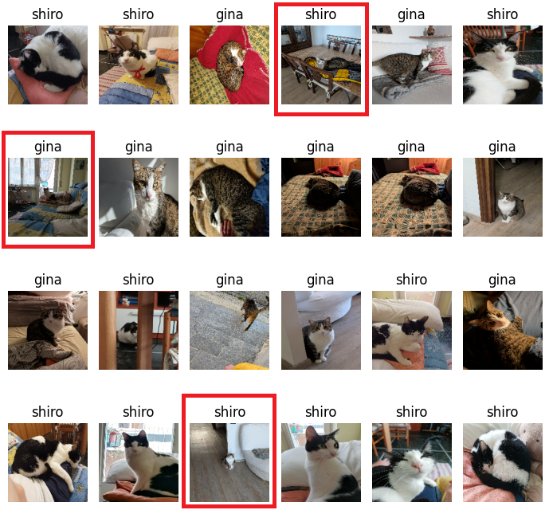
Error on the test

Slide 16
Conclusions
  We had a feeling that the model would classify the images only by looking at the surroundings rather than the cats. As it turns out, this is not really the case, as on all misclassified images, the model did not recognise the surroundings.
  The model performs surprisingly well for the limited size of the dataset, inside the misclassified images the cats are small and harder to identify or even see at all.

Slide 17
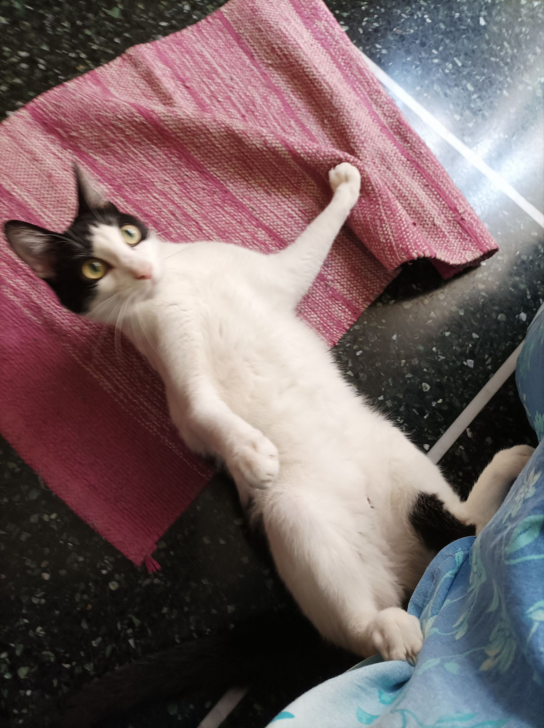
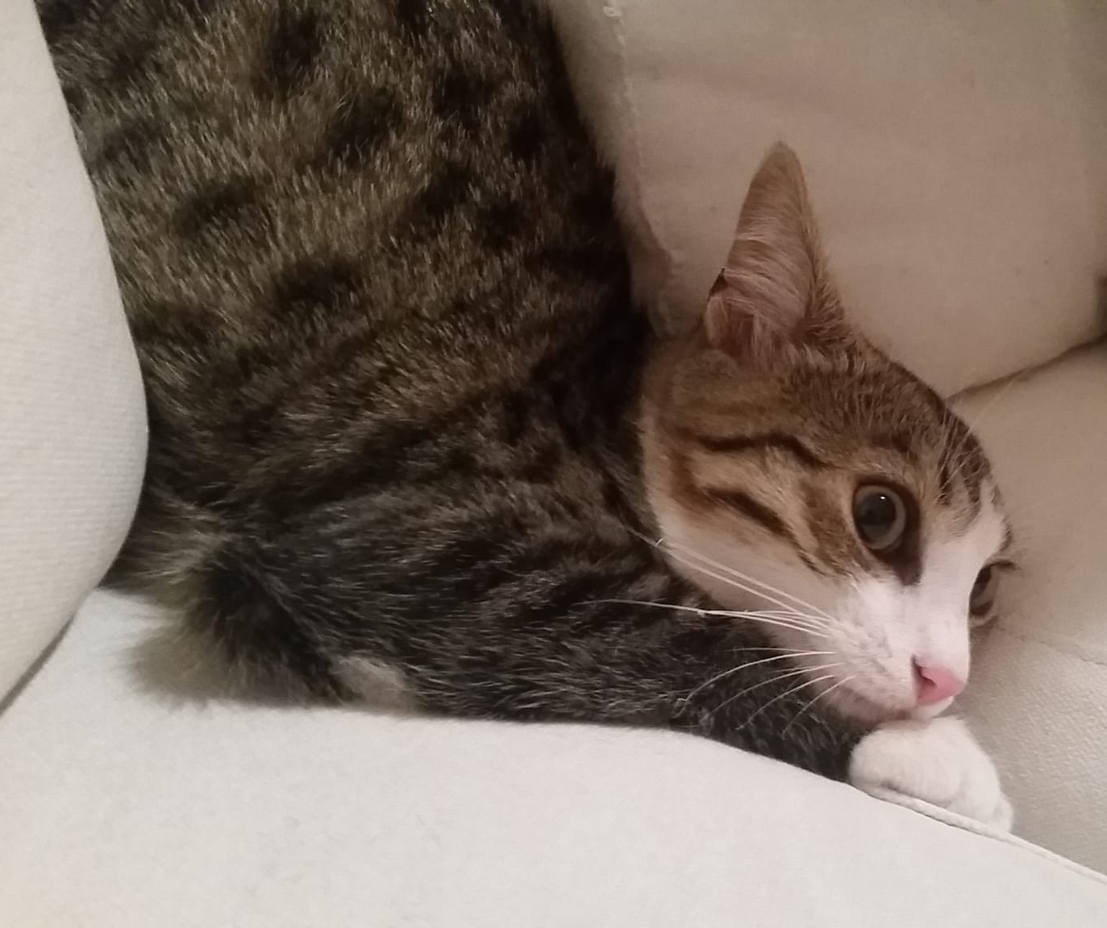
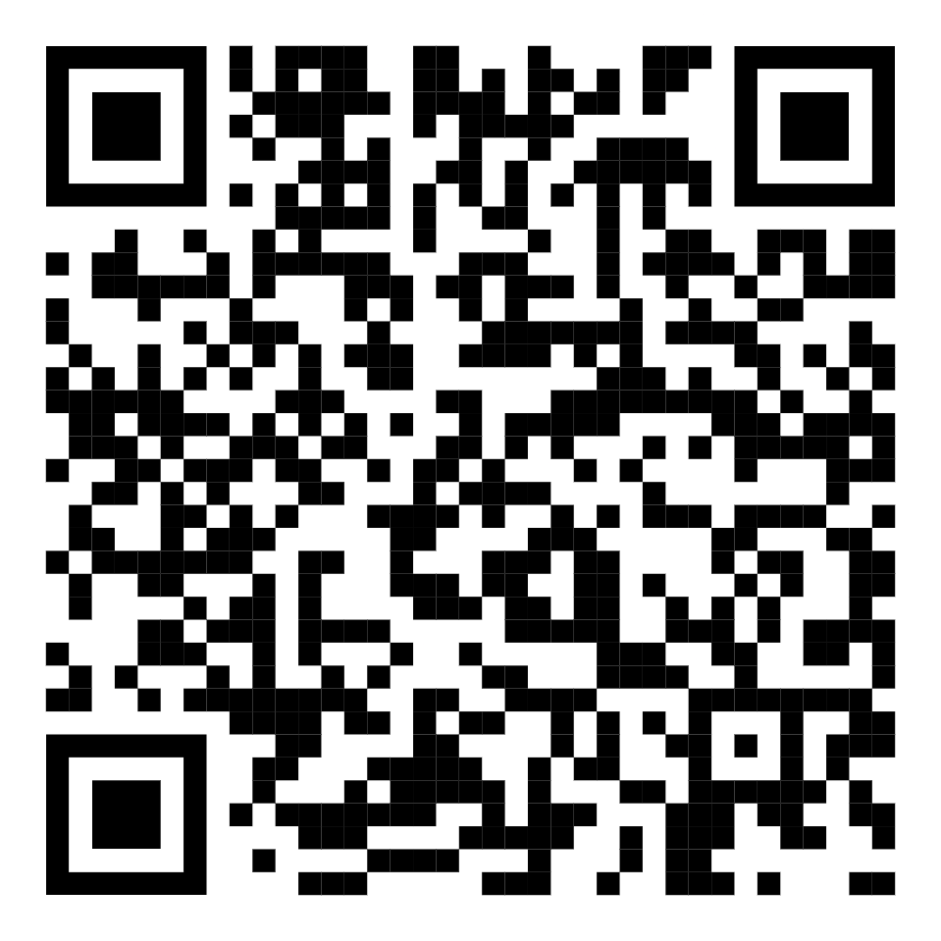
Thanks for the attention
thanks for the attention
thanks for the attention
https://github.com/lollomante/ML_Cats - No cats were harmed during the collection of the data.

Slide 18


